Slide 1

P peline
The Data
Correlation and Regression
© Jennifer Mankoff
The Data Pipeline; HCII; Spring 2014

Slide 2
Correlation

Slide 3
Continuous outcome (means)
Outcome Variable | Are the observations independent or correlated? |  | Alternatives if the normality assumption is violated (and small sample size):
 | independent | correlated
Continuous (e.g. pain scale, cognitive function) | T-test: compares means between two independent groups ANOVA: compares means between more than two independent groups Pearson’s correlation coefficient (linear correlation): shows linear correlation between two continuous variables Linear regression: multivariate regression technique used when the outcome is continuous; gives slopes | Paired t-test: compares means between two related groups (e.g., the same subjects before and after) Repeated-measures ANOVA: compares changes over time in the means of two or more groups (repeated measurements) Mixed models/GEE modeling: multivariate regression techniques to compare changes over time between two or more groups; gives rate of change over time | Non-parametric statistics Wilcoxon sign-rank test: non-parametric alternative to the paired ttest Wilcoxon sum-rank test (=Mann-Whitney U test): non-parametric alternative to the ttest Kruskal-Wallis test: non-parametric alternative to ANOVA Spearman rank correlation coefficient: non-parametric alternative to Pearson’s correlation coefficient
Adapted from: www.stanford.edu/~kcobb/hrp259/lecture13.ppt

Slide 4
Continuous outcome (means)
Outcome Variable | Are the observations independent or correlated? |  | Alternatives if the normality assumption is violated (and small sample size):
 | independent | correlated
Continuous (e.g. pain scale, cognitive function) | T-test: compares means between two independent groups ANOVA: compares means between more than two independent groups Pearson’s correlation coefficient (linear correlation): shows linear correlation between two continuous variables Linear regression: multivariate regression technique used when the outcome is continuous; gives slopes | Paired t-test: compares means between two related groups (e.g., the same subjects before and after) Repeated-measures ANOVA: compares changes over time in the means of two or more groups (repeated measurements) Mixed models/GEE modeling: multivariate regression techniques to compare changes over time between two or more groups; gives rate of change over time | Non-parametric statistics Wilcoxon sign-rank test: non-parametric alternative to the paired ttest Wilcoxon sum-rank test (=Mann-Whitney U test): non-parametric alternative to the ttest Kruskal-Wallis test: non-parametric alternative to ANOVA Spearman rank correlation coefficient: non-parametric alternative to Pearson’s correlation coefficient
Adapted from: www.stanford.edu/~kcobb/hrp259/lecture13.ppt

Slide 5
Continuous outcome (means)
Outcome Variable | Are the observations independent or correlated? |  | Alternatives if the normality assumption is violated (and small sample size):
 | independent | correlated
Continuous (e.g. pain scale, cognitive function) | T-test: compares means between two independent groups ANOVA: compares means between more than two independent groups Pearson’s correlation coefficient (linear correlation): shows linear correlation between two continuous variables Linear regression: multivariate regression technique used when the outcome is continuous; gives slopes | Paired t-test: compares means between two related groups (e.g., the same subjects before and after) Repeated-measures ANOVA: compares changes over time in the means of two or more groups (repeated measurements) Mixed models/GEE modeling: multivariate regression techniques to compare changes over time between two or more groups; gives rate of change over time | Non-parametric statistics Wilcoxon sign-rank test: non-parametric alternative to the paired ttest Wilcoxon sum-rank test (=Mann-Whitney U test): non-parametric alternative to the ttest Kruskal-Wallis test: non-parametric alternative to ANOVA Spearman rank correlation coefficient: non-parametric alternative to Pearson’s correlation coefficient
Adapted from: www.stanford.edu/~kcobb/hrp259/lecture13.ppt

Slide 6
Continuous outcome (means)
Outcome Variable | Are the observations independent or correlated? |  | Alternatives if the normality assumption is violated (and small sample size):
 | independent | correlated
Continuous (e.g. pain scale, cognitive function) | T-test: compares means between two independent groups ANOVA: compares means between more than two independent groups Pearson’s correlation coefficient (linear correlation): shows linear correlation between two continuous variables Linear regression: multivariate regression technique used when the outcome is continuous; gives slopes | Paired t-test: compares means between two related groups (e.g., the same subjects before and after) Repeated-measures ANOVA: compares changes over time in the means of two or more groups (repeated measurements) Mixed models/GEE modeling: multivariate regression techniques to compare changes over time between two or more groups; gives rate of change over time | Non-parametric statistics Wilcoxon sign-rank test: non-parametric alternative to the paired ttest Wilcoxon sum-rank test (=Mann-Whitney U test): non-parametric alternative to the ttest Kruskal-Wallis test: non-parametric alternative to ANOVA Spearman rank correlation coefficient: non-parametric alternative to Pearson’s correlation coefficient
Adapted from: www.stanford.edu/~kcobb/hrp259/lecture13.ppt

Slide 7
Goals
After today, you should be able to:
Calculate and interpret the simple correlation between two variables
Determine whether the correlation is significant
Check that your data meets the assumptions of correlation
Critique incorrect use of correlation
Adapted from http://www.fordham.edu/economics/Vinod/correl-regr.ppt

Slide 8
Continuous outcome (means)
Outcome Variable | Are the observations independent or correlated? |  | Alternatives if the normality assumption is violated (and small sample size):
 | independent | correlated
Continuous (e.g. pain scale, cognitive function) | T-test: compares means between two independent groups ANOVA: compares means between more than two independent groups Pearson’s correlation coefficient (linear correlation): shows linear correlation between two continuous variables Linear regression: multivariate regression technique used when the outcome is continuous; gives slopes | Paired t-test: compares means between two related groups (e.g., the same subjects before and after) Repeated-measures ANOVA: compares changes over time in the means of two or more groups (repeated measurements) Mixed models/GEE modeling: multivariate regression techniques to compare changes over time between two or more groups; gives rate of change over time | Non-parametric statistics Wilcoxon sign-rank test: non-parametric alternative to the paired ttest Wilcoxon sum-rank test (=Mann-Whitney U test): non-parametric alternative to the ttest Kruskal-Wallis test: non-parametric alternative to ANOVA Spearman rank correlation coefficient: non-parametric alternative to Pearson’s correlation coefficient
Adapted from: www.stanford.edu/~kcobb/hrp259/lecture13.ppt

Slide 9
Scatter Plots and Correlation
A scatter plot & correlation analysis are measures of association (linear relationship) between two variables
These variables change together
Usually scale (interval or ratio) variables

Slide 10
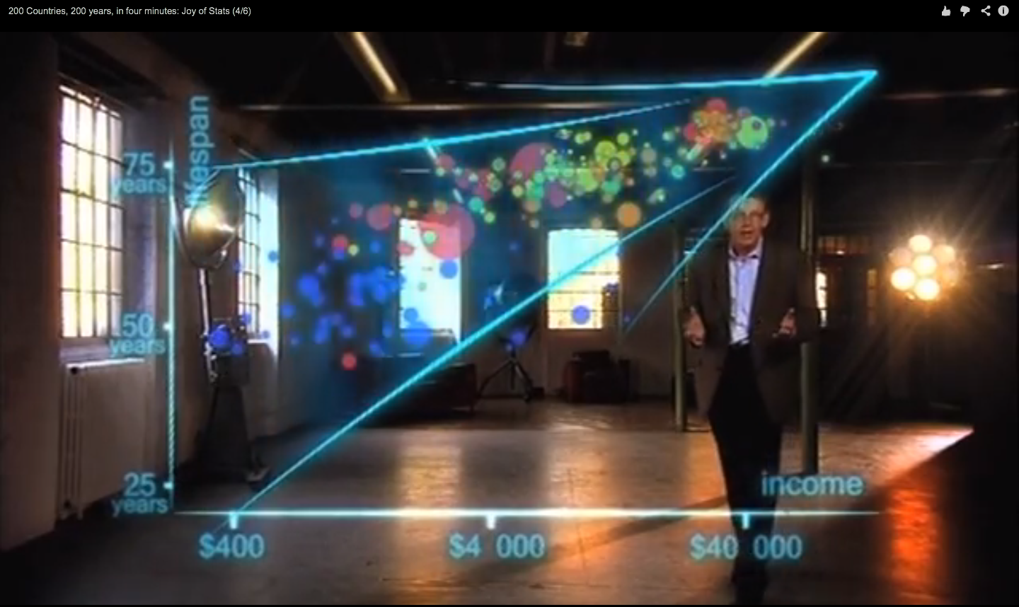
Hans Rosling on Health & Wealth
http://www.youtube.com/watch?v=ahp7QhbB8G4

Slide 11
What is “Linear”?
Remember this:
Y=mX+B?
m (slope)
B (intercept)
Adapted from: http://www.sjsu.edu/people/steven.macramalla/courses/stats95/s1/lecture 10
Notes:
A slope of 2 means that every 1-unit change in X yields a 2-unit change in Y.

Slide 12
Scatter Plot Examples
Linear relationships
Curvilinear relationships
y
y
x
x
y
y
x
x
Adapted from http://www.fordham.edu/economics/Vinod/correl-regr.ppt

Slide 13
Scatter Plot Examples
(continued)
Strong relationships
Weak relationships
y
y
x
x
y
y
x
x
Adapted from http://www.fordham.edu/economics/Vinod/correl-regr.ppt

Slide 14
Scatter Plot Examples
(continued)
No relationship
y
x
y
x
Adapted from http://www.fordham.edu/economics/Vinod/correl-regr.ppt

Slide 15
Pearson Correlation Coefficient
(continued)
The population correlation coefficient ρ (rho) measures the strength of the association between the variables
The sample correlation coefficient r is an estimate of ρ and is used to measure the strength of the linear relationship in the sample observations
Adapted from http://www.fordham.edu/economics/Vinod/correl-regr.ppt

Slide 16
Features of ρ and r
Unit free
Range between -1 and 1
The closer to 0, the weaker the linear relationship
Does not imply causality!
Adapted from http://www.fordham.edu/economics/Vinod/correl-regr.ppt

Slide 17
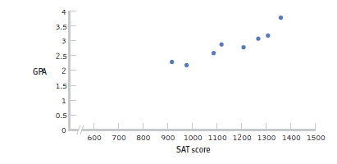
Positive Correlation
High scores on one variable tend to have high scores on the other variable
Adapted from: http://www.sjsu.edu/people/steven.macramalla/courses/stats95/s1/lecture 10

Slide 18
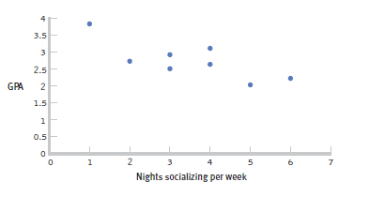
Negative Correlation
High scores on one variable tend to have low scores on the other variable ‘inverse relation’
Adapted from: http://www.sjsu.edu/people/steven.macramalla/courses/stats95/s1/lecture 10

Slide 19
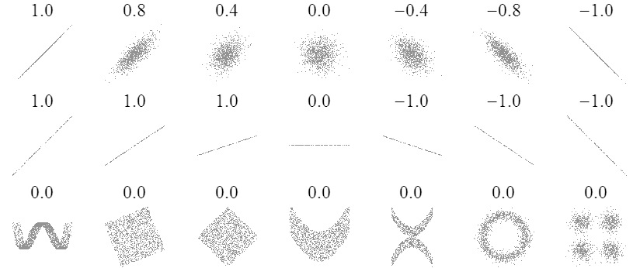
Sample Correlations
Adapted from: http://www.sjsu.edu/people/steven.macramalla/courses/stats95/s1/lecture 10
19

Slide 20
Check your learning
Which is stronger?
A correlation of 0.25 or -0.74?

Slide 21
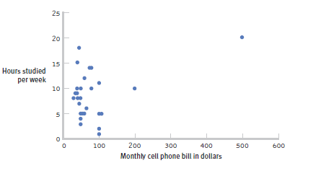
The effect of outliers
One outlier changed the correlation from -0.14 to 0.39!
Adapted from: http://www.sjsu.edu/people/steven.macramalla/courses/stats95/s1/lecture 10
Notes:
Note negative to positive change among other things

Slide 22
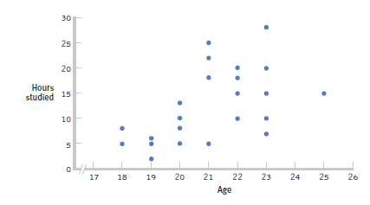
Restricted Range: Sampling Bias
Boys and girls who performed in the top 2% to 3% on standardized
Adapted from: http://www.sjsu.edu/people/steven.macramalla/courses/stats95/s1/lecture 10
Notes:
tests - a much smaller range than the full population from which the researchers could have drawn their sample.

Slide 23
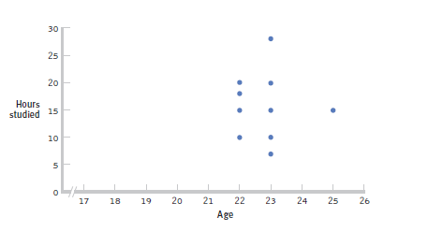
Further Restrictions
Only students between the ages of 22 and 25: r= 0.05.
Adapted from: http://www.sjsu.edu/people/steven.macramalla/courses/stats95/s1/lecture 10

Slide 24
Correlation Significance
Strength and significance both matter
Notes:
Equivalent to strength for a t-test? Size of difference

Slide 25
Correlation Hypothesis Testing
1 Identify the population, distribution, and assumptions

Slide 26
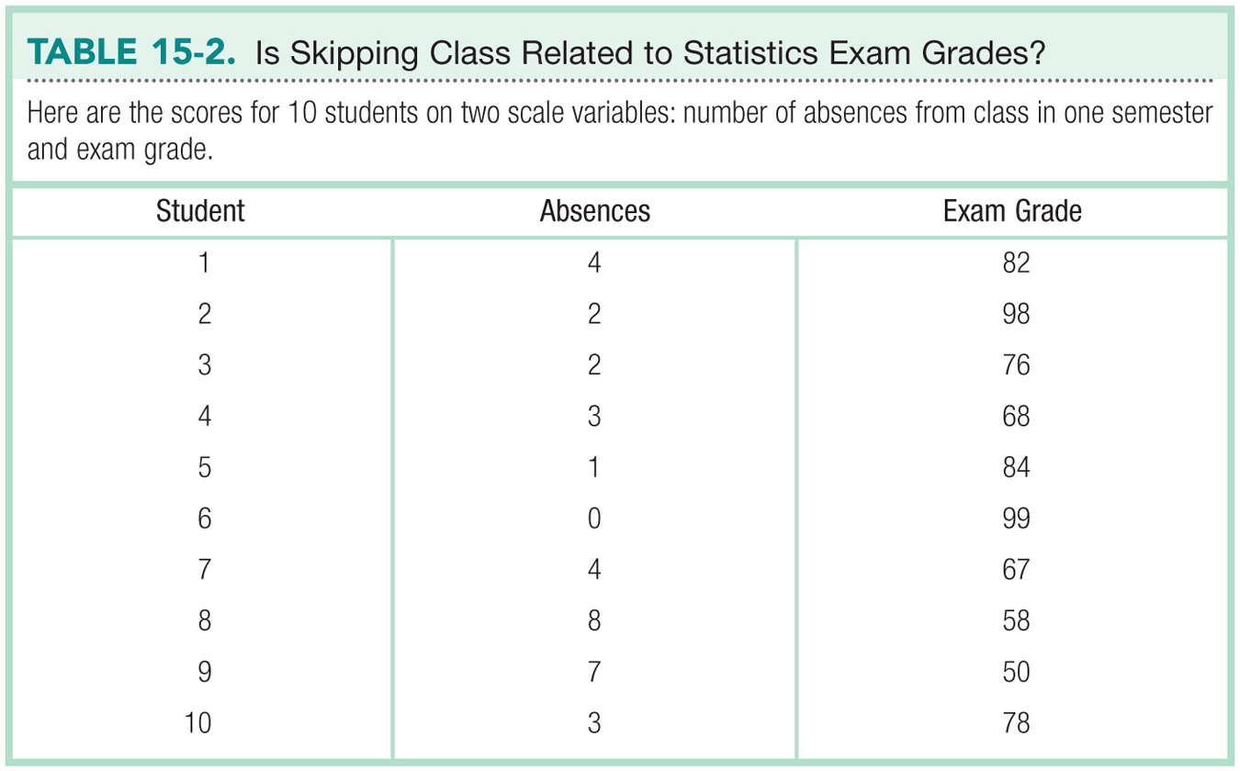
Adapted from: http://www.sjsu.edu/people/steven.macramalla/courses/stats95/s1/lecture 10

Slide 27
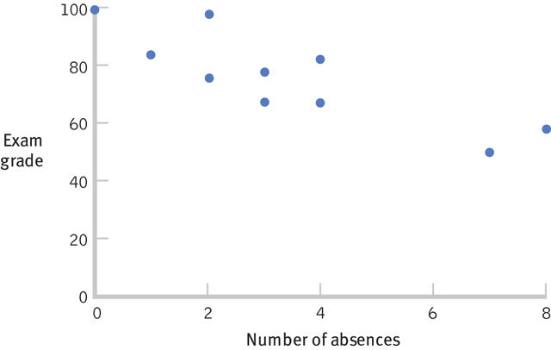
Always Start with a Scatterplot
Adapted from: http://www.sjsu.edu/people/steven.macramalla/courses/stats95/s1/lecture 10

Slide 28
Correlation Hypothesis Testing
1 Identify the population, distribution, and assumptions
2 State the null and research hypotheses

Slide 29
Correlation Hypothesis Testing
1 Identify the population, distribution, and assumptions
2 State the null and research hypotheses
H₀: There is no statistically significant relationship between the variables
H₁: There is a statistically significant relationship between the variables

Slide 30
Correlation Hypothesis Testing
1 Identify the population, distribution, and assumptions
2 State the null and research hypotheses
3 Determine the characteristics of the comparison distribution

Slide 31
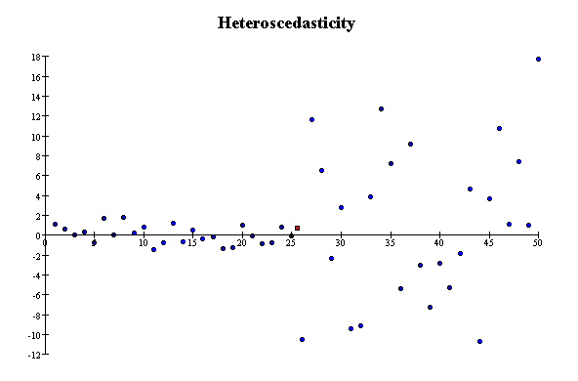
Correlation Assumptions
Key Assumptions:
X values are normally distributed within the population (for each Y)
Y values are normally distributed within the population (for each X)
X and Y have a linear relationship
There are no significant outliers
Scatter doesn’t vary over X or Y

Slide 32
Correlation Hypothesis Testing
1 Identify the population, distribution, and assumptions
2 State the null and research hypotheses
3 Determine the characteristics of the comparison distribution
4 Determine the critical values

Slide 33
Calculating the Pearson Correlation Coefficient
Sample correlation coefficient:
or the algebraic equivalent:
where:
r = Sample correlation coefficient
n = Sample size
x = Value of the independent variable
y = Value of the dependent variable
Adapted from http://www.fordham.edu/economics/Vinod/correl-regr.ppt

Slide 34
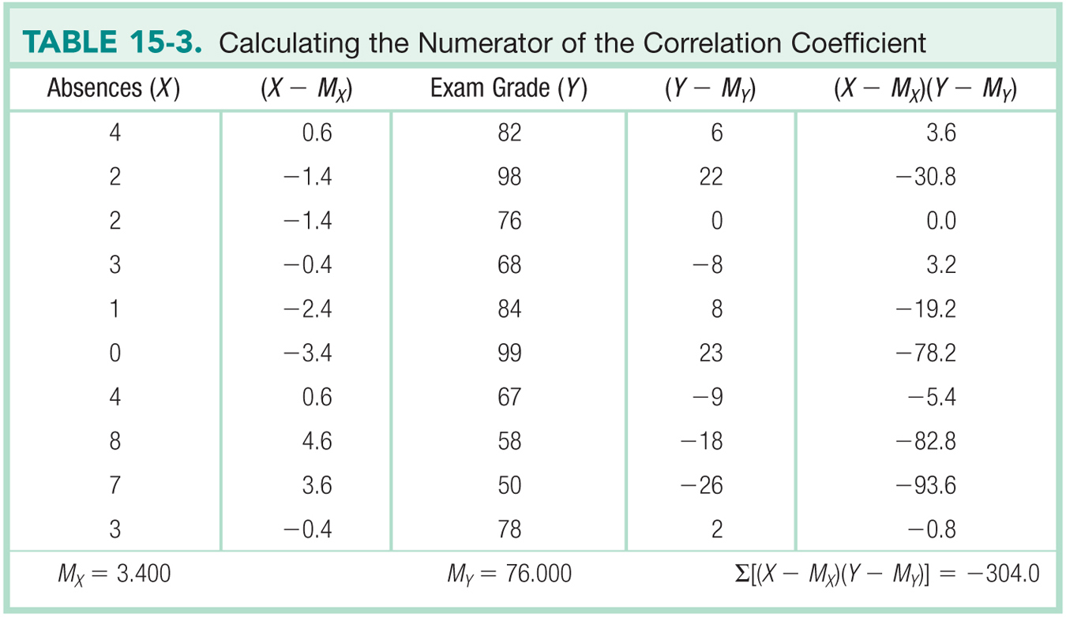
Adapted from: http://www.sjsu.edu/people/steven.macramalla/courses/stats95/s1/lecture 10

Slide 35
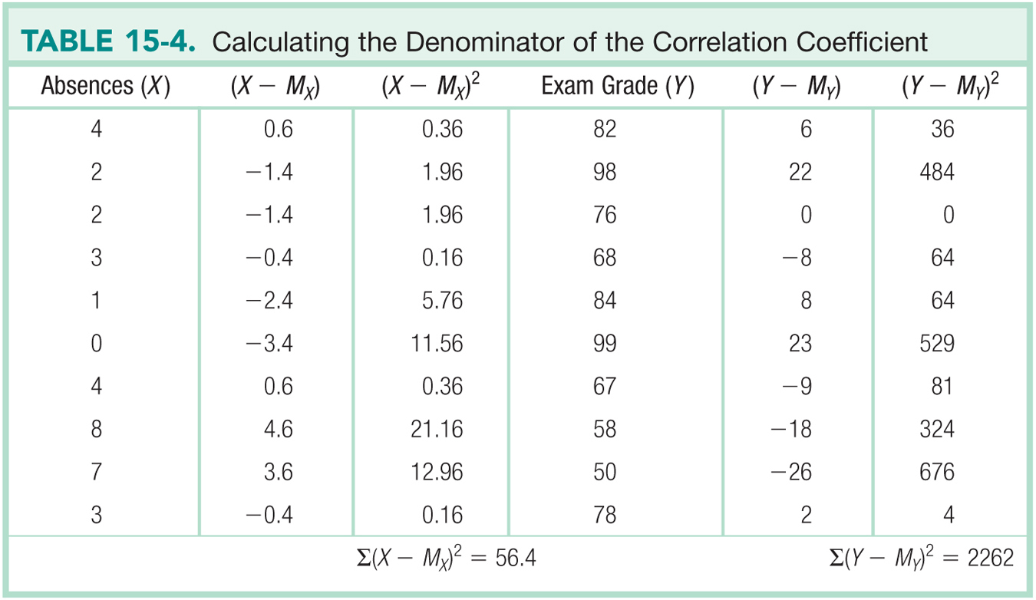
Adapted from: http://www.sjsu.edu/people/steven.macramalla/courses/stats95/s1/lecture 10

Slide 36
Calculating the Pearson Correlation Coefficient
Sample correlation coefficient:

Slide 37
Calculating the Pearson Correlation Coefficient
We know there is as strong, inverse relationship. Is it significant?

Slide 38
Significance Test for Correlation
Adapted from http://www.fordham.edu/economics/Vinod/correl-regr.ppt

Slide 39
Correlation Hypothesis Testing
1 Identify the population, distribution, and assumptions
2 State the null and research hypotheses
3 Determine the characteristics of the comparison distribution
4 Determine the critical values
5 State decision rule |t| < |t| => H₁ is rejected

Slide 40
Significance Test for Correlation
d.f. = 10-2 = 8
α/2=.025
α/2=.025
Reject H₀
-t_{α/2}
Do not reject H₀
t_{α/2}
Reject H₀
0
2.306
-2.306
4.56
Adapted from http://www.fordham.edu/economics/Vinod/correl-regr.ppt

Slide 41
Correlation Hypothesis Testing
1 Identify the population, distribution, and assumptions
2 State the null and research hypotheses
3 Determine the characteristics of the comparison distribution
4 Determine the critical values
5 State decision rule |t| < |t| => H₁ is rejected
6 State conclusion |-4.56| > 2.36 => Reject H₀
Correlation is significant with 95% confidence

Slide 42
The limits of correlation

Slide 43
Correlation is not Causation
There is a 0.91 correlation between ice cream consumption and drowning deaths.
Does eating ice cream cause drowning?
Does grief cause us to eat more ice cream?
Adapted from: http://www.sjsu.edu/people/steven.macramalla/courses/stats95/s1/lecture 10

Slide 44
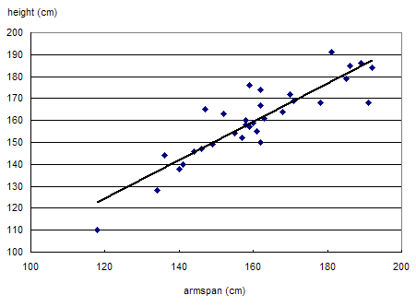
Correlation is not Causation
Armspan and height are strongly correlated.
Adapted from: http://www.sjsu.edu/people/steven.macramalla/courses/stats95/s1/lecture 10

Slide 45
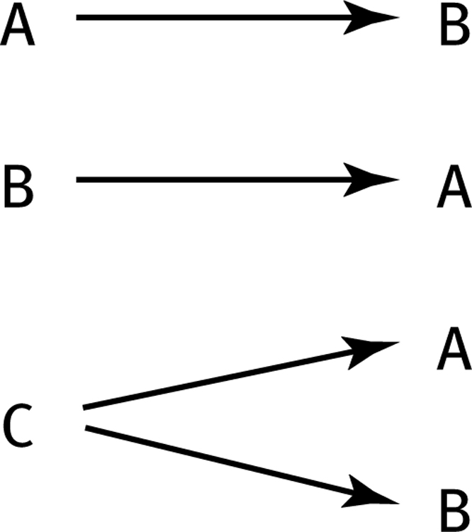
The Limitations of Correlation
Three Possible Causal Explanations for a Correlation
Adapted from: http://www.sjsu.edu/people/steven.macramalla/courses/stats95/s1/lecture 10

Slide 46
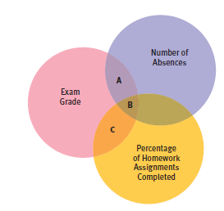
Partial Correlation
Quantifies the degree of association between two variables after statistically removing the association of a third variable with both of those two variables.
e.g., number of absences and exam grade, over and above the correlation of percentage of completed homework assignments with these variables.
Adapted from: http://www.sjsu.edu/people/steven.macramalla/courses/stats95/s1/lecture 10

Slide 47
Example
A study of graduates’ salaries showed negative association between economists’ starting salary and the level of the degree
PhDs earned less than Masters degree holders, who in turn earned less than those with just a Bachelor’s degree
Why?
The data was split into three employment sectors
Teaching, government and private industry
Each sector showed a positive relationship
Employer type was confounded with degree level
Adapted from: http://www.sjsu.edu/people/steven.macramalla/courses/stats95/s1/lecture 10

Slide 48
Simpson’s Paradox
http://en.wikipedia.org/wiki/Simpson's_paradox
Introducing another variable may change our understanding of the data
It may even reverse the initial conclusions

Slide 49
A situation where the subgroups are always the way to go
 | Treatment A | Treatment B
Small Stones | Group 1 93% (81/87) | Group 2 87% (234/270)
Large Stones | Group 3 73% (192/263) | Group 4 69% (55/80)
Both | 78% (273/350) | 83% (289/350)
Notes:
The practical significance of Simpson's paradox surfaces in decision making situations where it poses the following dilemma: Which data should we consult in choosing an action, the aggregated or the partitioned? In the Kidney Stone example above, it is clear that if one is diagnosed with "Small Stones" or "Large Stones" the data for the respective subpopulation should be consulted and Treatment A would be preferred to Treatment B. But what if a patient is not diagnosed, and the size of the stone is not known; would it be appropriate to consult the aggregated data and administer Treatment B? This would stand contrary to common sense; a treatment that is preferred both under one condition and under its negation should also be preferred when the condition is unknown.

Slide 50
Gender Discrimination?
 | Applicants | Admitted
Men | 8442 | 44%
Women | 4321 | 35%
Notes:
On the other hand, if the partitioned data is to be preferred a priori, what prevents one from partitioning the data into arbitrary sub-categories (say based on eye color or post-treatment pain) artificially constructed to yield wrong choices of treatments? Pearl[2] shows that, indeed, in many cases it is the aggregated, not the partitioned data that gives the correct choice of action. Worse yet, given the same table, one should sometimes follow the partitioned and sometimes the aggregated data, depending on the story behind the data; with each story dictating its own choice. Pearl[2] considers this to be the real paradox behind Simpson's reversal.

Slide 51
Gender Discrimination?
Dept | Men | Women
A | 825/62% | 108/82%
B | 560/63% | 25/68%
C | 325/37% | 593/34%
D | 417/33% | 375/35%
E | 191/28% | 393/24%
F | 373/6% | 341/7%
Bickel et al.[13]: women tended to apply to competitive departments with low rates of admission (English), men tended to apply to less-competitive departments with high rates of admission engineering and chemistry)
Notes:
On the other hand, if the partitioned data is to be preferred a priori, what prevents one from partitioning the data into arbitrary sub-categories (say based on eye color or post-treatment pain) artificially constructed to yield wrong choices of treatments? Pearl[2] shows that, indeed, in many cases it is the aggregated, not the partitioned data that gives the correct choice of action. Worse yet, given the same table, one should sometimes follow the partitioned and sometimes the aggregated data, depending on the story behind the data; with each story dictating its own choice. Pearl[2] considers this to be the real paradox behind Simpson's reversal.

Slide 52
How can we test these associations?
Three Possible Causal Explanations for a Correlation
Adapted from: http://www.sjsu.edu/people/steven.macramalla/courses/stats95/s1/lecture 10

Slide 53
Randomized Trial (gold standard)
Assume A and B_{i} are correlated…
Measure current (A) state)
Activity
Measure (B_{i})

Slide 54
Randomized Trial (gold standard)
Assume A and B_{i} are correlated…
And that Activity links them
Measure current (A) state)
Activity
Measure (B_{i})

Slide 55
Randomized Trial (gold standard)
Recruit Participants
Activity becomes the intervention
Randomize
Measure current (A) state)
Measure current (A) state)
Measure current (A) state)
Intervention Group
Control Group
Activity
Measure (B_{i})
Measure (B_{c})
Measure (B_{i})

Slide 56
Randomized Trial (gold standard)
Recruit Participants
Activity becomes the intervention
Randomize
Measure current (A) state)
Measure current (A) state)
Measure current (A) state)
Intervention Group
Control Group
Activity
Measure (B_{i})
Measure (B_{c})
Measure (B_{i})
Test for significant difference between A & B_{i}; B_{i} and B_{c}; A & B_{c}

Slide 57
Continuous outcome (means)
Outcome Variable | Are the observations independent or correlated? |  | Alternatives if the normality assumption is violated (and small sample size):
 | independent | correlated
Continuous (e.g. pain scale, cognitive function) | T-test: compares means between two independent groups ANOVA: compares means between more than two independent groups Pearson’s correlation coefficient (linear correlation): shows linear correlation between two continuous variables Linear regression: multivariate regression technique used when the outcome is continuous; gives slopes | Paired t-test: compares means between two related groups (e.g., the same subjects before and after) Repeated-measures ANOVA: compares changes over time in the means of two or more groups (repeated measurements) Mixed models/GEE modeling: multivariate regression techniques to compare changes over time between two or more groups; gives rate of change over time | Non-parametric statistics Wilcoxon sign-rank test: non-parametric alternative to the paired ttest Wilcoxon sum-rank test (=Mann-Whitney U test): non-parametric alternative to the ttest Kruskal-Wallis test: non-parametric alternative to ANOVA Spearman rank correlation coefficient: non-parametric alternative to Pearson’s correlation coefficient
Adapted from: www.stanford.edu/~kcobb/hrp259/lecture13.ppt

Slide 58
Regression

Slide 59
Goals for Regression
After this, you should be able to:
Calculate and interpret the simple linear regression equation for a set of data
Understand the assumptions behind regression analysis
Determine whether a regression model is significant
Adapted from http://www.fordham.edu/economics/Vinod/correl-regr.ppt

Slide 60
Goals for Regression
(continued)
After this, you should be able to:
Recognize regression analysis applications for purposes of prediction and description
Recognize some potential problems if regression analysis is used incorrectly
Recognize nonlinear relationships between two variables
Adapted from http://www.fordham.edu/economics/Vinod/correl-regr.ppt

Slide 61
Statistical Regression Analysis
Regression analysis is used to:
Predict the value of a dependent variable based on the value of at least one independent variable
Explain the impact of changes in an independent variable on the dependent variable
Dependent variable: the variable we wish to explain
Independent variable: the variable used to do so
Adapted from http://www.fordham.edu/economics/Vinod/correl-regr.ppt

Slide 62
Relationship with correlation
In correlation, the two variables are treated as equals.
In regression, one variable is considered independent (=predictor) variable (X) and the other the dependent (=outcome) variable Y.

Slide 63
Regression in Machine Learning
Regression analysis is used to:
Predict the value of a continues variable based on the value of one or more features
Dependent variable: the outcome we wish to predict
Features: summaries of information about things we measured that should predict the outcome

Slide 64
Simple Linear Regression Model
Only one independent variable, x
Relationship between x and y is described by a linear function
Changes in y are assumed to be caused by changes in x
Adapted from http://www.fordham.edu/economics/Vinod/correl-regr.ppt

Slide 65
Population Linear Regression
The population regression model:
Population Slope Coefficient
Random Error term, or residual
Population y intercept
Independent Variable
Dependent Variable
Linear component
Random Error
component
Adapted from http://www.fordham.edu/economics/Vinod/correl-regr.ppt

Slide 66
Population Linear Regression
y
Observed Value of y for x_{i}
Random Error for x_{i}
ε_{i}
Slope = β₁
Predicted Value of y for x_{i}
Regression Line
Intercept = β₀
x_{i}
x
Adapted from http://www.fordham.edu/economics/Vinod/correl-regr.ppt

Slide 67
Estimated Regression Model
y
Estimated Intercept = b₀
Estimated Regression Line
Estimated Slope = b₁
x
Notes:
Is this any good? How do you know?

Slide 68
Better Estimate
y
Random Error for x_{i}
e_{i}
b₁
b₀
x
x
Notes:
Better?

Slide 69
Estimated Regression Model
y
Observed y for x_{i}
Random Error for x_{i}
e_{i}
b₁
Predicted for x_{i}
b₀
x
x_{i}
x
The individual random error terms e_{i} have a mean of zero
Notes:
We need to solve for y by estimating b0 and b1
b₀ is the estimated average value of y when the value of x is zero
b₁ is the estimated change in the average value of y as a result of a one-unit change in x
The simple regression line always passes through the mean of the y variable and the mean of the x variable

Slide 70
Least Squares Criterion
b₀ and b₁ must minimize
y
e_{i}
Estimated Slope = b₁
Intercept = b₀
x

Slide 71
Least Squares Criterion
b₀ and b₁ must minimize
y
Observed Value of y for x_{i}
e_{i}
Estimated Slope = b₁
Predicted Value for x_{i}
Intercept = b₀
x
Notes:
Note we can replace y-cap with b0 – b1x

Slide 72
Least Squares Criterion
b₀ and b₁ must minimize
Adapted from http://www.fordham.edu/economics/Vinod/correl-regr.ppt
Notes:
Note we can replace y-cap with b0 – b1x

Slide 73
Least Squares Regression Properties
The sum of the residuals from the least squares regression line is 0.
The sum of the squared residuals is a minimum.
The simple regression line always passes through the mean of the y variable and the mean of the x variable.
The least squares coefficients are unbiased estimates of β₀ and β₁.
Adapted from www.clt.astate.edu/asyamil/groebner/ppts/PP11final.ppt

Slide 74
Linear Regression Assumptions
Error values (ε) are statistically independent
Error values are normally distributed for any given value of x
The probability distribution of the errors is normal
The probability distribution of the errors has constant variance
The underlying relationship between the x variable and the y variable is linear
Adapted from www.clt.astate.edu/asyamil/groebner/ppts/PP11final.ppt
Notes:
In machine learning we can play with these a bit – will get to this next week

Slide 75
Simple Linear Regression Example
A real estate agent wishes to examine the relationship between the selling price of a home and its size (measured in square feet)
A random sample of 10 houses is selected
Dependent variable (y) = house price in $1000s
Independent variable (x) = square feet
Adapted from http://www.fordham.edu/economics/Vinod/correl-regr.ppt

Slide 76
Sample Data for House Price Model
House Price in $1000s (y) | Square Feet (x)
245 | 1400
312 | 1600
279 | 1700
308 | 1875
199 | 1100
219 | 1550
405 | 2350
324 | 2450
319 | 1425
255 | 1700
Adapted from http://www.fordham.edu/economics/Vinod/correl-regr.ppt

Slide 77
Graphical Presentation
House price model: scatter plot and regression line
Slope
= 0.10977
Intercept
= 98.248
Adapted from http://www.fordham.edu/economics/Vinod/correl-regr.ppt
Notes:
Here, no houses had 0 square feet, so b₀ = 98.24833 just indicates that, for houses within the range of sizes observed, $98,248.33 is the portion of the house price not explained by square feet

Slide 78
Graphical Presentation
House price model: scatter plot and regression line
Slope
= 0.10977
Intercept
= 98.248
Adapted from http://www.fordham.edu/economics/Vinod/correl-regr.ppt

Slide 79
Graphical Presentation
House price model: scatter plot and regression line
Slope
= 0.10977
Intercept
= 98.248
Adapted from http://www.fordham.edu/economics/Vinod/correl-regr.ppt
Notes:
Here, b₁ = .10977 tells us that the average value of a house increases by .10977($1000) = $109.77, on average, for each additional one square foot of size

Slide 80
Example: House Prices
Estimated Regression Equation:
House Price in $1000s (y) | Square Feet (x)
245 | 1400
312 | 1600
279 | 1700
308 | 1875
199 | 1100
219 | 1550
405 | 2350
324 | 2450
319 | 1425
255 | 1700
Predict the price for a house with 2000 square feet
Adapted from http://www.fordham.edu/economics/Vinod/correl-regr.ppt

Slide 81
Example: House Prices
Estimated Regression Equation:
House Price in $1000s (y) | Square Feet (x)
245 | 1400
312 | 1600
279 | 1700
308 | 1875
199 | 1100
219 | 1550
405 | 2350
324 | 2450
319 | 1425
255 | 1700
Predict the price for a house with 2000 square feet
Adapted from http://www.fordham.edu/economics/Vinod/correl-regr.ppt

Slide 82
Example: House Prices
Estimated Regression Equation:
House Price in $1000s (y) | Square Feet (x)
245 | 1400
312 | 1600
279 | 1700
308 | 1875
199 | 1100
219 | 1550
405 | 2350
324 | 2450
319 | 1425
255 | 1700
Predict the price for a house with 2000 square feet
The predicted price for a house with 2000 square feet is 317.85($1,000s) = $317,850
Adapted from http://www.fordham.edu/economics/Vinod/correl-regr.ppt

Slide 83
Further Analysis: Test for significance
t test for a population slope
Is there a linear relationship between x and y?
Null and alternative hypotheses
H₀: β₁ = 0 (no linear relationship)
H₁: β₁ ≠ 0 (linear relationship does exist)
Test statistic
where:
b₁ = Sample regression slope
coefficient
β₁ = Hypothesized slope
s_{b1} = Estimator of the standard
error of the slope

Slide 84
Simple Linear Regression Analysis
COEFFICIENT OF DETERMINATION (R²)
(sum of squares regression)
(total sum of squares)
Notes:
The coefficient of determination is the portion of the total variation in the dependent variable that is explained by its relationship with the independent variable. The coefficient of determination is also called R-squared and is denoted as R2.

Slide 85
Simple Linear Regression Analysis
COEFFICIENT OF DETERMINATION (R²)
House Price in $1000s (y) | Square Feet (x) | Predicted House Price (ŷ)
245 | 1400 | 251.97
312 | 1600 | 273.93
279 | 1700 | 284.91
308 | 1875 | 304.125
199 | 1100 | 219.03
219 | 1550 | 268.44
405 | 2350 | 356.28
324 | 2450 | 367.26
319 | 1425 | 254.715
255 | 1700 | 284.91
Notes:
The coefficient of determination is the portion of the total variation in the dependent variable that is explained by its relationship with the independent variable. The coefficient of determination is also called R-squared and is denoted as R2.

Slide 86
Simple Linear Regression Analysis
COEFFICIENT OF DETERMINATION (R²)
House Price in $1000s (y) | Square Feet (x) | Predicted House Price (ŷ)
245 | 1400 | 251.97
312 | 1600 | 273.93
279 | 1700 | 284.91
308 | 1875 | 304.125
199 | 1100 | 219.03
219 | 1550 | 268.44
405 | 2350 | 356.28
324 | 2450 | 367.26
319 | 1425 | 254.715
255 | 1700 | 284.91
Predicted y
Notes:
The coefficient of determination is the portion of the total variation in the dependent variable that is explained by its relationship with the independent variable. The coefficient of determination is also called R-squared and is denoted as R2.

Slide 87
Simple Linear Regression Analysis
COEFFICIENT OF DETERMINATION (R²)
House Price in $1000s (y) | Square Feet (x) | Predicted House Price (ŷ)
245 | 1400 | 251.97
312 | 1600 | 273.93
279 | 1700 | 284.91
308 | 1875 | 304.125
199 | 1100 | 219.03
219 | 1550 | 268.44
405 | 2350 | 356.28
324 | 2450 | 367.26
319 | 1425 | 254.715
255 | 1700 | 284.91
Mean y
Notes:
The coefficient of determination is the portion of the total variation in the dependent variable that is explained by its relationship with the independent variable. The coefficient of determination is also called R-squared and is denoted as R2.

Slide 88
Simple Linear Regression Analysis
COEFFICIENT OF DETERMINATION (R²)
House Price in $1000s (y) | Square Feet (x) | Predicted House Price (ŷ)
245 | 1400 | 251.97
312 | 1600 | 273.93
279 | 1700 | 284.91
308 | 1875 | 304.125
199 | 1100 | 219.03
219 | 1550 | 268.44
405 | 2350 | 356.28
324 | 2450 | 367.26
319 | 1425 | 254.715
255 | 1700 | 284.91
Mean y = 286.5
Notes:
The coefficient of determination is the portion of the total variation in the dependent variable that is explained by its relationship with the independent variable. The coefficient of determination is also called R-squared and is denoted as R2.

Slide 89
Simple Linear Regression Analysis
COEFFICIENT OF DETERMINATION (R²)
House Price in $1000s (y) | Square Feet (x) | Predicted House Price (ŷ)
245 | 1400 | 251.97
312 | 1600 | 273.93
279 | 1700 | 284.91
308 | 1875 | 304.125
199 | 1100 | 219.03
219 | 1550 | 268.44
405 | 2350 | 356.28
324 | 2450 | 367.26
319 | 1425 | 254.715
255 | 1700 | 284.91
Notes:
The coefficient of determination is the portion of the total variation in the dependent variable that is explained by its relationship with the independent variable. The coefficient of determination is also called R-squared and is denoted as R2.

Slide 90
Simple Linear Regression Analysis
COEFFICIENT OF DETERMINATION (R²)
House Price in $1000s (y) | Square Feet (x) | Predicted House Price (ŷ)
245 | 1400 | 251.97
312 | 1600 | 273.93
279 | 1700 | 284.91
308 | 1875 | 304.125
199 | 1100 | 219.03
219 | 1550 | 268.44
405 | 2350 | 356.28
324 | 2450 | 367.26
319 | 1425 | 254.715
255 | 1700 | 284.91
Notes:
The coefficient of determination is the portion of the total variation in the dependent variable that is explained by its relationship with the independent variable. The coefficient of determination is also called R-squared and is denoted as R2.

Slide 91
Standard Error of Estimate
The standard deviation of the variation of observations around the regression line is estimated by
Where
SSE = Sum of squares error
n = Sample size
k = number of independent variables in the model
Adapted from http://www.fordham.edu/economics/Vinod/correl-regr.ppt

Slide 92
Explained and Unexplained Variation
(continued)
SST = total sum of squares
Measures the variation of the y_{i} values around their mean y
SSE = error sum of squares (used for Std. Error)
Variation attributable to factors other than the relationship between x and y
SSR = regression sum of squares (used for R²)
Explained variation attributable to the relationship between x and y

Slide 93
Explained and Unexplained Variation
(continued)
y
y_{i}
∧
∧
SSE = ∑(y_{i} - y_{i} )²
y
_
SST = ∑(y_{i} - y)²
∧
y
_
∧
_
SSR = ∑(y_{i} - y)²
_
y
y
x
X_{i}

Slide 94
Unexplained error in House Price Model (SSE)
Unexplained variation makes R² .581
Intercept
= 98.248
Notes:
Here, b₁ = .10977 tells us that the average value of a house increases by .10977($1000) = $109.77, on average, for each additional one square foot of size

Slide 95
Residual Analysis
Purposes
Examine for linearity assumption
Examine for constant variance for all levels of x
Evaluate normal distribution assumption
Graphical Analysis of Residuals
Can plot residuals vs. x
Can create histogram of residuals to check for normality
Adapted from http://www.fordham.edu/economics/Vinod/correl-regr.ppt

Slide 96
Residual Analysis for Linearity
y
y
x
x
residuals
x
x
residuals
✓
Not Linear
Linear
Slide from: Statistics for Managers Using Microsoft® Excel 4th Edition, 2004 Prentice-Hall

Slide 97
Residual Analysis for Constant Variance (Homoscedasticity)
y
y
x
x
residuals
x
x
residuals
✓
Non-constant variance
Constant variance
Slide from: Statistics for Managers Using Microsoft® Excel 4th Edition, 2004 Prentice-Hall

Slide 98
Residual Analysis for Independence
✓
Not Independent
Independent
residuals
X
residuals
X
residuals
X
Slide from: Statistics for Managers Using Microsoft® Excel 4th Edition, 2004 Prentice-Hall

Slide 99
Multiple Linear Regression
More than one predictor…
E(y)= α + β₁*X + β₂ *W + β₃ *Z…
Each regression coefficient is the amount of change in the outcome variable that would be expected per one-unit change of the predictor, if all other variables in the model were held constant.

Slide 100
Multivariate regression pitfalls
Multi-co-linearity
Two x’s that measure the same thing
Tend to ‘cancel out’ and wreck the model

Slide 101
Multivariate regression pitfalls
Multi-co-linearity
Two x’s that measure the same thing
Tend to ‘cancel out’ and wreck the model
Residual confounding
Hard to estimate

Slide 102
Multivariate regression pitfalls
Multi-co-linearity
Two x’s that measure the same thing
Tend to ‘cancel out’ and wreck the model
Residual confounding
Hard to estimate
Overfitting
Too many x’s for the data
Minimum 10 new samples per new x
Makes the model less predictive on new samples

Slide 103
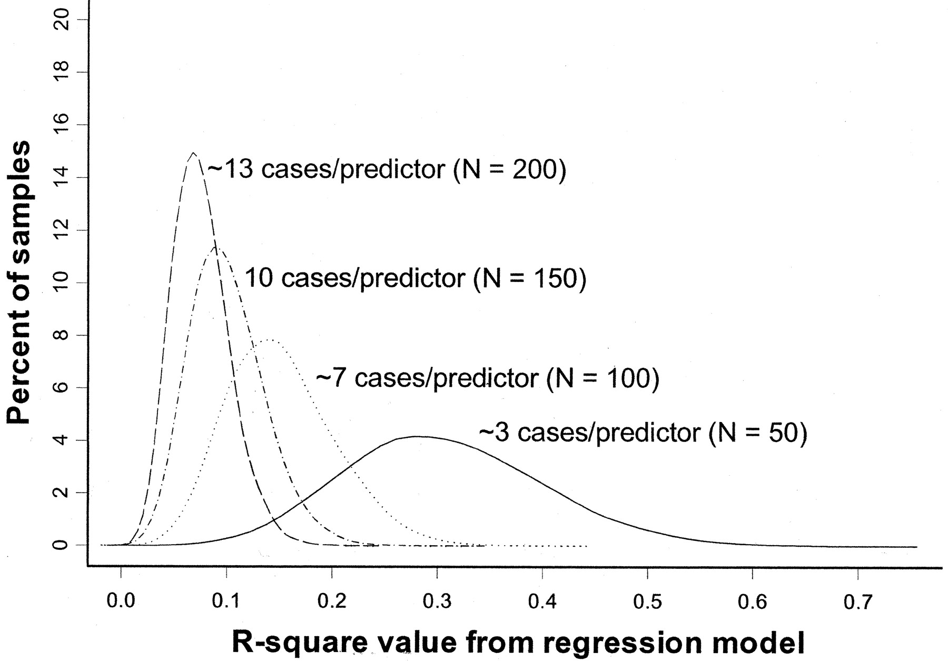
Overfitting
Rule of thumb: You need at least 10 subjects for each additional predictor variable in the multivariate regression model.
Pure noise variables still produce good R² values if the model is overfitted. The distribution of R² values from a series of simulated regression models containing only noise variables.
(Figure 1 from: Babyak, MA. What You See May Not Be What You Get: A Brief, Nontechnical Introduction to Overfitting in Regression-Type Models. Psychosomatic Medicine 66:411-421 (2004).)

Slide 104
Summary
Introduced correlation analysis
Discussed correlation to measure the strength of a linear association
Introduced simple linear regression analysis
Calculated the coefficients for the simple linear regression equation
Addressed assumptions of regression and correlation
Addressed prediction of individual values
Discussed residual analysis
Adapted from http://www.fordham.edu/economics/Vinod/correl-regr.ppt

Slide 105
Continuous outcome (means)
Outcome Variable | Are the observations independent or correlated? |  | Alternatives if the normality assumption is violated (and small sample size):
 | independent | correlated
Continuous (e.g. pain scale, cognitive function) | T-test: compares means between two independent groups ANOVA: compares means between more than two independent groups Pearson’s correlation coefficient (linear correlation): shows linear correlation between two continuous variables Linear regression: multivariate regression technique used when the outcome is continuous; gives slopes | Paired t-test: compares means between two related groups (e.g., the same subjects before and after) Repeated-measures ANOVA: compares changes over time in the means of two or more groups (repeated measurements) Mixed models/GEE modeling: multivariate regression techniques to compare changes over time between two or more groups; gives rate of change over time | Non-parametric statistics Wilcoxon sign-rank test: non-parametric alternative to the paired ttest Wilcoxon sum-rank test (=Mann-Whitney U test): non-parametric alternative to the ttest Kruskal-Wallis test: non-parametric alternative to ANOVA Spearman rank correlation coefficient: non-parametric alternative to Pearson’s correlation coefficient
Adapted from: www.stanford.edu/~kcobb/hrp259/lecture13.ppt

Slide 106
Binary or categorical outcomes (proportions)
Outcome Variable | Are the observations correlated? |  | Alternative to the chi-square test if sparse cells:
 | independent | correlated
Binary or categorical (e.g. fracture, yes/no) | Chi-square test: compares proportions between two or more groups Relative risks: odds ratios or risk ratios Logistic regression: multivariate technique used when outcome is binary; gives multivariate-adjusted odds ratios | McNemar’s chi-square test: compares binary outcome between correlated groups (e.g., before and after) Conditional logistic regression: multivariate regression technique for a binary outcome when groups are correlated (e.g., matched data) GEE modeling: multivariate regression technique for a binary outcome when groups are correlated (e.g., repeated measures) | Fisher’s exact test: compares proportions between independent groups when there are sparse data (some cells <5). McNemar’s exact test: compares proportions between correlated groups when there are sparse data (some cells <5).
Adapted from: www.stanford.edu/~kcobb/hrp259/lecture13.ppt

